Slide 1
Memory Management
VIRTUAL MEMORY

Slide 2
Virtual Memory
virtual memory is a technique that allows the execution of processes which are not completely available in memory.
The main visible advantage of this scheme is that programs can be larger than physical memory.
Virtual memory is the separation of user logical memory from physical memory.
This separation allows an extremely large virtual memory to be provided for programmers when only a smaller physical memory is available.

Slide 3
Why Need Virtual Memory?
Here, are reasons for using virtual memory:
Whenever your computer doesn't have space in the physical memory it writes what it needs to remember to the hard disk in a swap file as virtual memory.
If a computer running Windows needs more memory/RAM, then installed in the system, it uses a small portion of the hard drive for this purpose.

Slide 4
Virtual Memory
Following are the situations, when entire program is not required to be loaded fully in main memory.
User written error handling routines are used only when an error occurred in the data or computation.
Certain options and features of a program may be used rarely.
Many tables are assigned a fixed amount of address space even though only a small amount of the table is actually used.
The ability to execute a program that is only partially in memory would counter many benefits.
Less number of I/O would be needed to load or swap each user program into memory.
A program would no longer be constrained by the amount of physical memory that is available.
Each user program could take less physical memory, more programs could be run the same time, with a corresponding increase in CPU utilization and throughput.

Slide 5
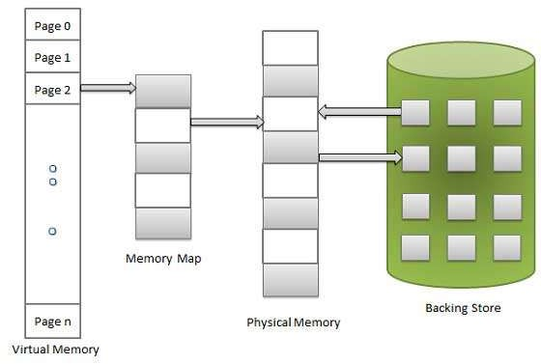
Virtual Memory
Virtual memory is commonly implemented by demand paging.
It can also be implemented in a segmentation system. Demand segmentation can also be used to provide virtual memory.

Slide 6
Types of Virtual Memory/ RAM?
The first step of knowing about virtual memories is to learn their classification. Computers handle virtual memory either through paging or segmentation.
So, the type of virtual memory depends on how it’s being handled. Below is a bigger picture about them:
Paging
This kind of virtual memory operates by partitioning memory into parts known as paging files.
When RAM is full, it moves any unused pages to the specific part of a hard drive designated for virtual memory.
This procedure is executed by the computer utilizing a swap file.
A swap file is a predefined area on the hard drive for expanding the virtual memory of the RAM.
Moving unnecessary data to the hard drive makes some free RAM space for necessary activities and guarantees that the system ever runs out of actual memory.

Slide 7
The computer utilizes page tables to convert virtual addresses into physical addresses.
This is one as only a part of the instruction processing system by the Memory Management Unit of the computer.
Segmenting
Another technique of controlling virtual memory is called ‘segmenting’.
This process splits virtual memory into segments of different lengths and transfers unused segments from the virtual memory of the computer to the hard drive.
Segment tables, like page tables, keep track of whether a segment is stored in the memory or as a physical address.
The difference between segmenting and paging is that segmenting parts memory into different lengths, while paging divides memory into equal-sized pieces.
In paging, the computer's hardware decides section size, while in segmentation, the user may choose segment length.

Slide 8
Benefits of Virtual Memory/ RAM?
Having a virtual memory can be of real advantage for the users, especially in critical situations.
Here are some of the best advantages that come with virtual memory.
Segmented Speed Rise
Virtual memory doesn't bother using the whole RAM to gain a certain level of speed.
Instead, it assists a particular segment of the whole program to gain an expected speed.
It uses the segment only when the segment of the program needs to execute a necessary instruction or run another program.
Memory Share
Programmers and designers often need systems that can share data or information between memory.
They will find a virtual memory system quite helpful.
The process can communicate data and instructions via and between memory.

Slide 9
Benefits of Virtual Memory/ RAM?
Multi-programming Environment
If users need to make a multi-programming environment, they should use a virtual memory system.
Such memory provides the extra support that smoothens the multi-programming environment.
Furthermore, virtual memory helps users do large programs into comparatively smaller programs.
There is no specific multi-programming limit.
Data Placement
Another big perk with virtual memory is users can place their data and codes anywhere in the physical memory without a relocation.
These data or codes can be read anytime from the disc.
Users will find the process larger than other physical memories.
Users will get more space for virtual addresses compared to physical memory.

Slide 10
Benefits of Virtual Memory/ RAM?
Checks External Fragmentation
When unused memory is split into smaller segments and interleaved with assigned memory, this is known as external fragmentation.
It is considered an issue as an algorithm for storage allocation, especially when these algorithms fail to effectively arrange memory utilized by applications.
No Memory Holes
Memory holes may cause unusual fragmentation.
However, virtual memory overcomes this problem since it does not contact the physical memory management unit.
Furthermore, each program has its individual mapping, and users can utilize the mapping to place their program data anywhere they want in the RAM.
Security
Each program has the ability to access any 32bit memory address.
The issue arises when two programs use the same address in address space to keep their results.
In that case, the output of one program may be altered by another, resulting in users not receiving the desired outcome.
It is the most serious issue that virtual memory can address.

Slide 11
The advantages to using virtual memory include:
Checks External Fragmentation
It can handle twice as many addresses as main memory.
It enables more applications to be used at once.
It frees applications from managing shared memory and saves users from having to add memory modules when RAM space runs out.
It has increased speed when only a segment of a program is needed for execution.
It has increased security because of memory isolation.
It enables multiple larger applications to run simultaneously.
Allocating memory is relatively inexpensive.
It does not need external fragmentation.
CPU use is effective for managing logical partition workloads.
Data can be moved automatically.
Pages in the original process can be shared during a fork system call operation that creates a copy of itself.

Slide 12
The limitations of using virtual memory
Although the use of virtual memory has its benefits, it also comes with some tradeoffs worth considering, such as:
Applications run slower if they are running from virtual memory.
Data must be mapped between virtual and physical memory, which requires extra hardware support for address translations, slowing down a computer further.
The size of virtual storage is limited by the amount of secondary storage, as well as the addressing scheme with the computer system.
Thrashing can occur if there is not enough RAM, which will make the computer perform slower.
It may take time to switch between applications using virtual memory.
It lessens the amount of available hard drive space.

